Slide 1

Strategic Partnership for Industry 4.0 innovation advanced Training
Common Part – 360 degrees of digitalization
The European Commission support for the production of this publication does not constitute endorsement of the contents which reflects the views only of the authors, and the Commission cannot be held responsible for any use which may be made of the information contained therein.

Slide 2

Digital Transformation
Each one has the objective of improving the key points of the functionality and profitability of the enterprise.
The progression and low cost of some relevant technologies are acting as dinamizers of the Digital Transformation.
Innovate and create new products and services
Redefinition of the internal flows of the enterprise
Digitalization of the organization
Digitalization of the experience of the client

Slide 3
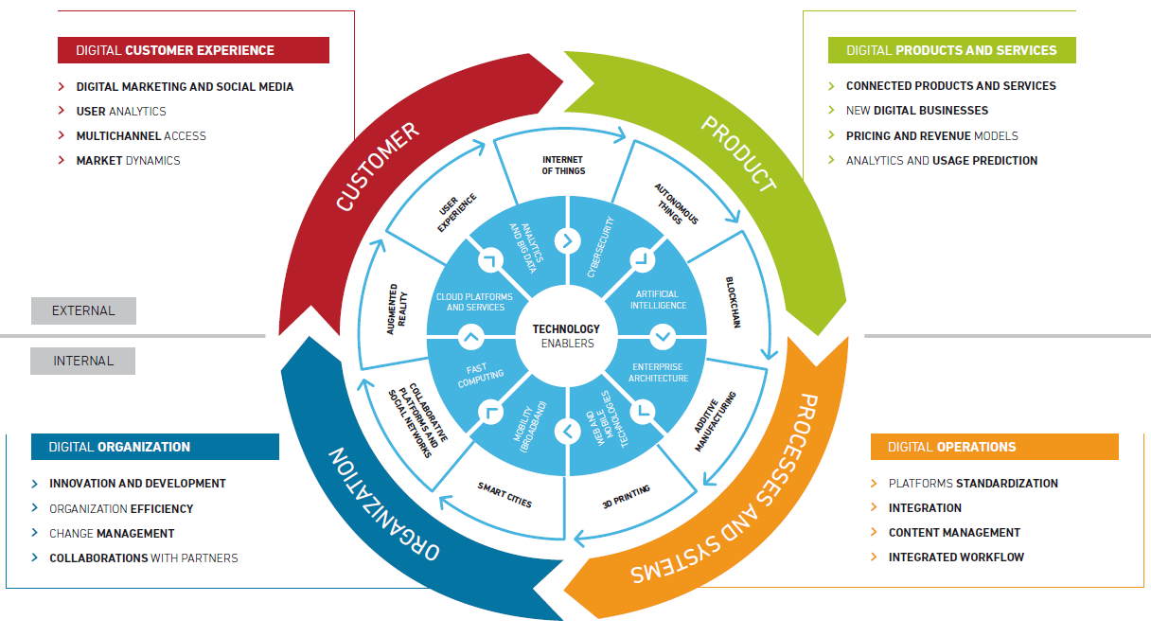
Digitalization wheel

Slide 4
Costumer
The progress of the new digital economy is becoming a priority for the most important companies. This change forces us to compete on an increasingly global scale and, in turn, stimulates the company's processes: improving the relationship with the customer, but also streamlining supply chains and improving products and services.
With the digital transformation, the company's sales can be distributed through several digital channels, in addition to the physical one. Customers are increasing their purchases through the internet and using product comparisons before deciding. Therefore, companies must update the way they sell and market their products.
Market dynamics
Multi(Omni)-channel access

Slide 5
Costumer
The digital transformation facilitates that a lot of information can be gathered from the client's browsing through the company's webs, a necessary previous step so that with sufficient analytical technology means the users' preferences can be understood, segmented and then be able to act offering products of predictive form.
With digital transformation and multichannel environments, it is necessary to create a new marketing model and the use of new technological support tools. In addition, social networks are also a good opportunity to interact with customers and promote the products and services of the company.
User Analytics
Digital Marketing and Social Media

Slide 6
Product
As the use of IoT grows, new products appear that are connected to the Internet in both domestic and industrial environments, with the explosion of the Industrial Internet. These new connected products facilitate, in turn, the appearance of new services. However, there are limitations that must be taken into account and are being solved, such as the speed of the Internet, the volume of data, especially in industrial applications.
Taking advantage of digital technologies, new business models are being created that redefine traditionally established limits - digital disruption.
Connected products and services
New Digital Business

Slide 7
Product
As new competitors appear, it is important to have a pricing strategy since customers are constantly connected and compared. Therefore, the company needs to know which models of prices are most suitable dynamically.
Currently, much information can be extracted from the large amount of data generated by automated processes and customer interactions through the company's Internet platforms. You can apply analytics and rules to the data flow in, through and outside the company (applications, databases, mobile, social, Internet of things) to get the desired information. From these results, you can make informed decisions and perform the most appropriate actions.
Pricing and revenue models
Analytics and usage prediction

Slide 8
Organization
As digitalization trends progress, it becomes necessary to adopt innovation in products and services as proactive tasks within the company that affect both physical and digital products.
Digitization is changing the shape and size of organizations, it is necessary to rethink internal work flows to avoid teams with duplicated tasks, being inefficient
Innovation and Development
Organizational efficiency

Slide 9
Organization
Change management is the process of transitioning employees, teams and organizations to a new state following a planning. Digitization impacts new ways of working and collaborating not only in the company itself, but also to customers and suppliers.
With digital transformation it is easier to establish collaborations with external partners through technological integrations that allow the interconnection of products, processes and services without the restriction of physical location.
In such a changing environment as today, establishing collaborations with collaborative partners can help achieve competitive advantages.
Change Management
Collaboration with partners

Slide 10
Systems and Processes
New digital models, such as e-commerce, need traditional supply chains to adapt to the new environment by changing the way companies are operating internally.
The digital contents must be managed, that is, well stored and their access and use controlled, since they constitute the assets that generate income for the company.
Integrated Workflow
Content Management

Slide 11
Systems and Processes
Digitization impacts the way customers interact with the company. The Internet offers unrestricted accessibility that forces companies to adopt new ways in how they sell their products and services.
It is necessary to adapt quickly to the new needs of the market. The ability to quickly change internal processes and have a set of standard services that allow them to integrate with third parties quickly must be evaluated.
Integration
Platforms Standardization

Slide 12
Technology as the engine for the Digital Transformation
Acceso
universal

